Slide 1



Clustering of ICA components EEGLAB
Arnaud Delorme
Julie Onton
Romain Grandchamp
Nima Bigdely Shamlo
Scott Makeig
Practical MEEG 2025, Aix-Marseille Université, France, October, 2025

Slide 2
Steps of clustering
Select ICA components for clustering
Precompute measures of interest
Cluster measures
Plot clusters and edit them if necessary

Slide 3
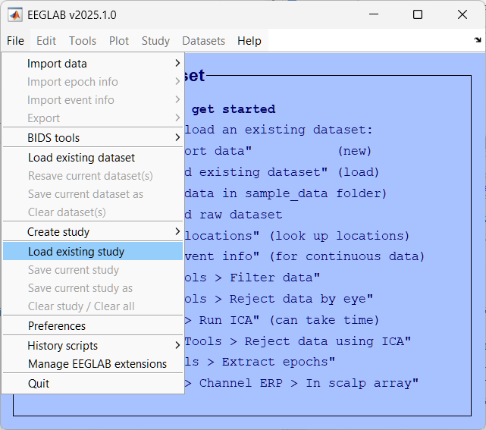
Load an existing STUDY
ds002718_processed/Face_detection.study

Slide 4
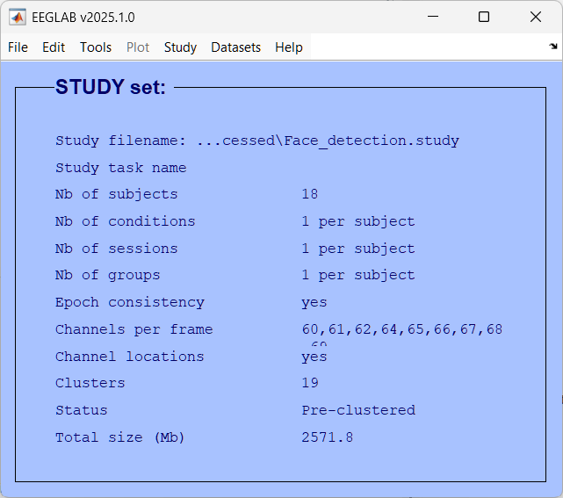

Slide 5
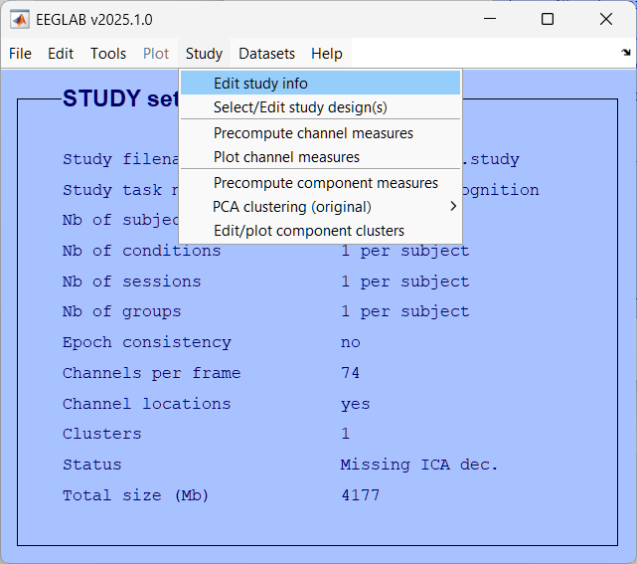
Study/Edit study info

Slide 6
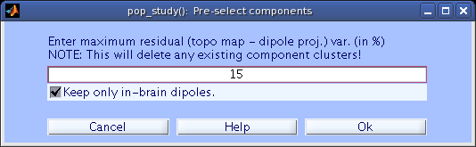
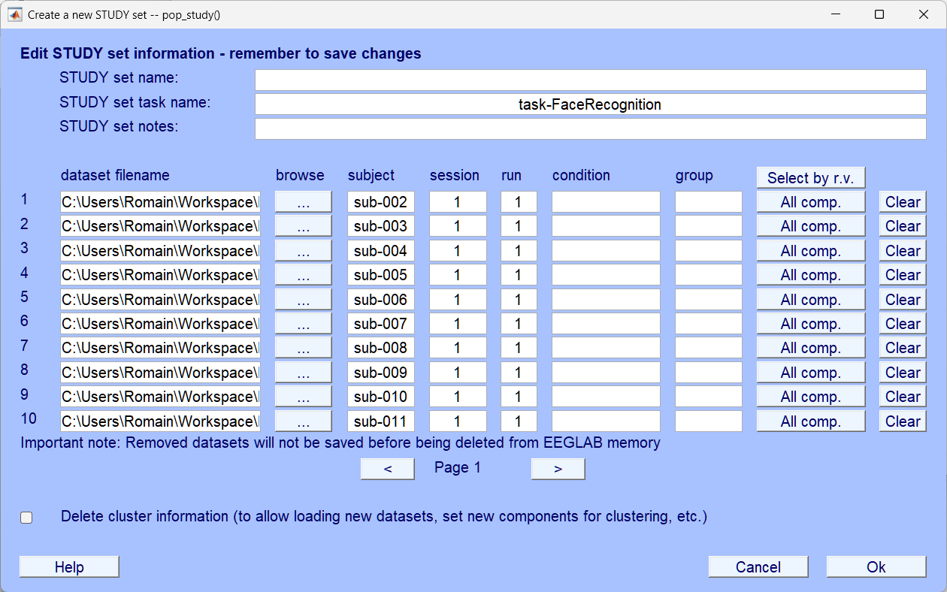
Edit dataset info
Notes:
Next, 8 consonant letters (spanning approximately 2- of visual angle) were presented in succession at fixation. Of these, 3, 5 or 7 (colored black) were to be memorized, while the remaining 5, 3 or 1, respectively (colored green) were to be ignored. Letter stimulus duration was 1.2 s, with stimulus onset asynchrony (SOA) fixed at 1.4 s. (In a separate short-stimulus control condition, letter duration was 0.15 s.) In place of a ninth letter, a dash appeared on the screen to signal the beginning of a variable 2 – 4 s memory Maintenance period during which subjects silently rehearsed the identities of the memorized letters. A probe letter (colored red) then appeared, prompting the subject to respond by pressing one of two buttons (with the thumb or index finger of their dominant hand) to indicate whether or not the probe letter had been in the Memorize-letter set in that trial. An auditory feedback signal (a confirmatory beep or cautionary buzz), presented 400 ms after the button press, informed the subject whether his/her answer was correct or incorrect. After a self-selected, variable delay, the subject initiated the next trial by pressing either response button, triggering the reappearance of the fixation cross
(https://www.creact.co.jp/wp-content/uploads/2020/03/Frontal-midline-EEG-dynamics-during-working-memory.pdf#page=16&zoom=100,0,0)

Slide 7
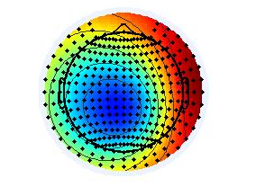
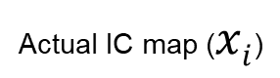
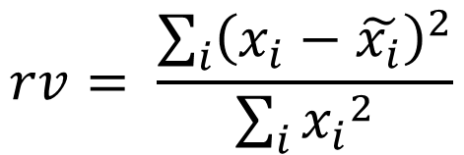

Computing residual variance (%)
Actual IC map ($xi$)
Dipole projection ($\tilde{xi}$)
$$rv= \frac{\sum_{i}{{\left(x_{i}−\tilde{x_{i}}\right)}^{2}}}{\sum_{i}{{x_{i}}^{2}}}$$

Slide 8
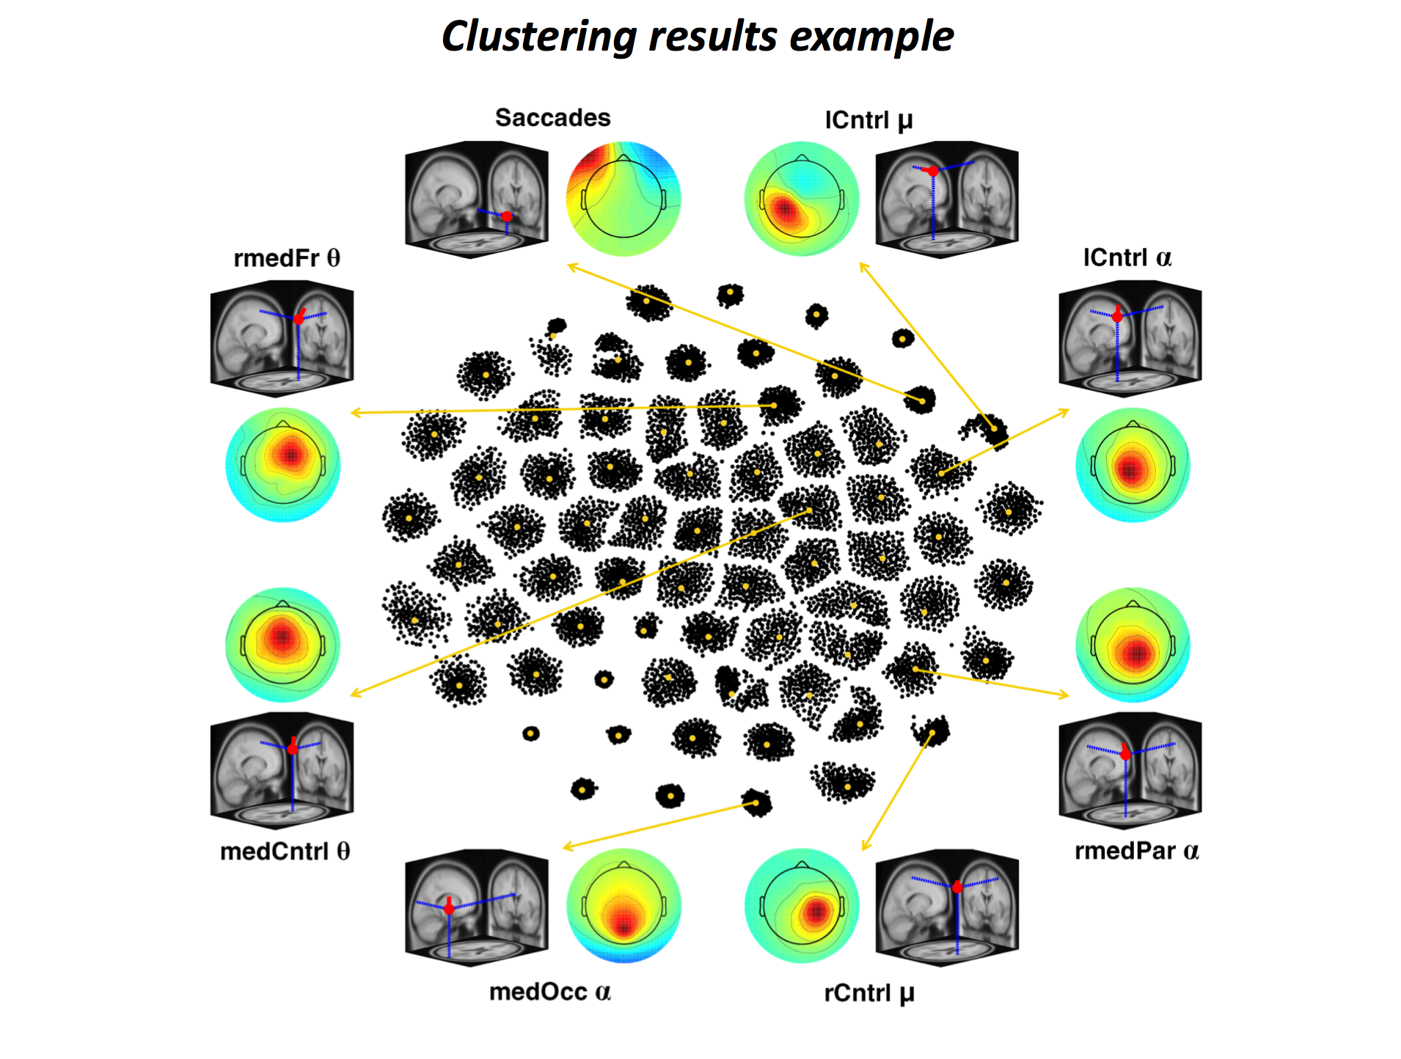

Notes:
RELICA first computes IC “dipolarity” a measure of physiological plausibility, plus a measure of IC consistency across multiple decompositions of bootstrap versions of the input data. RELICA then uses these two measures to visualize and cluster the separated ICs, providing a within-subject measure of IC reliability that does not involve checking for its occurrence across subjects.
Authors demonstrated the use of RELICA on EEG data recorded from 14 subjects performing a working memory experiment and show that many brain and ocular artifact ICs are correctly classified as “stable” (highly repeatable across decompositions of bootstrapped versions of the input data). Many stable ICs appear to originate in the brain, while other stable ICs account for identifiable non-brain processes such as line noise. RELICA might be used with any linear blind source separation algorithm to reduce the risk of basing conclusions on unstable or physiologically uninterpretable component processes.

Slide 9
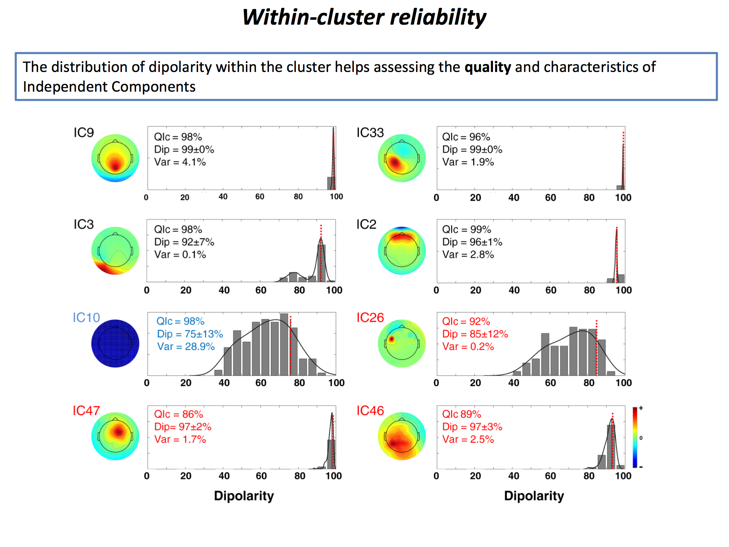

Slide 10
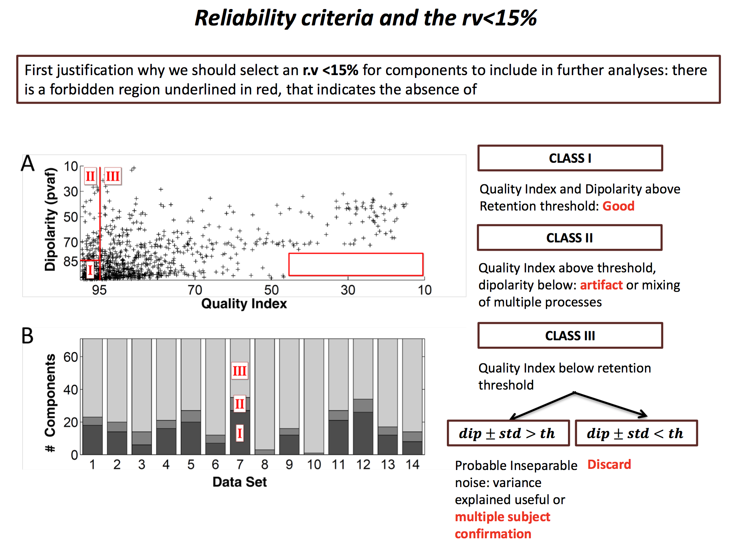

Slide 11
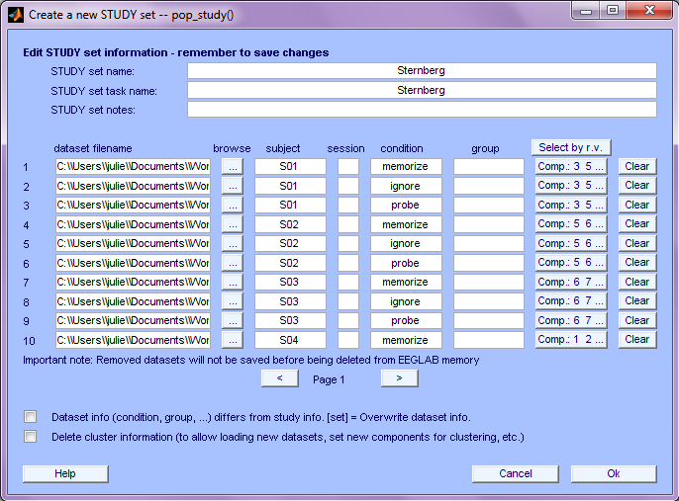
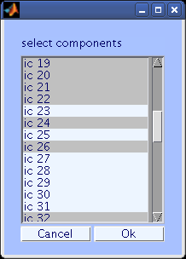
ICs to cluster

Slide 12
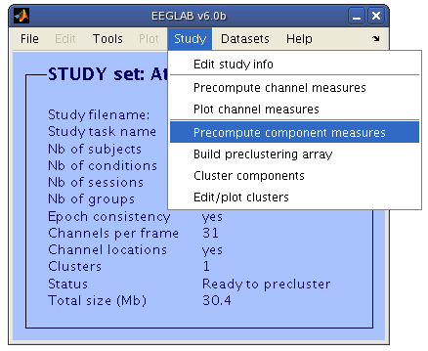
Precompute data measures

Slide 13
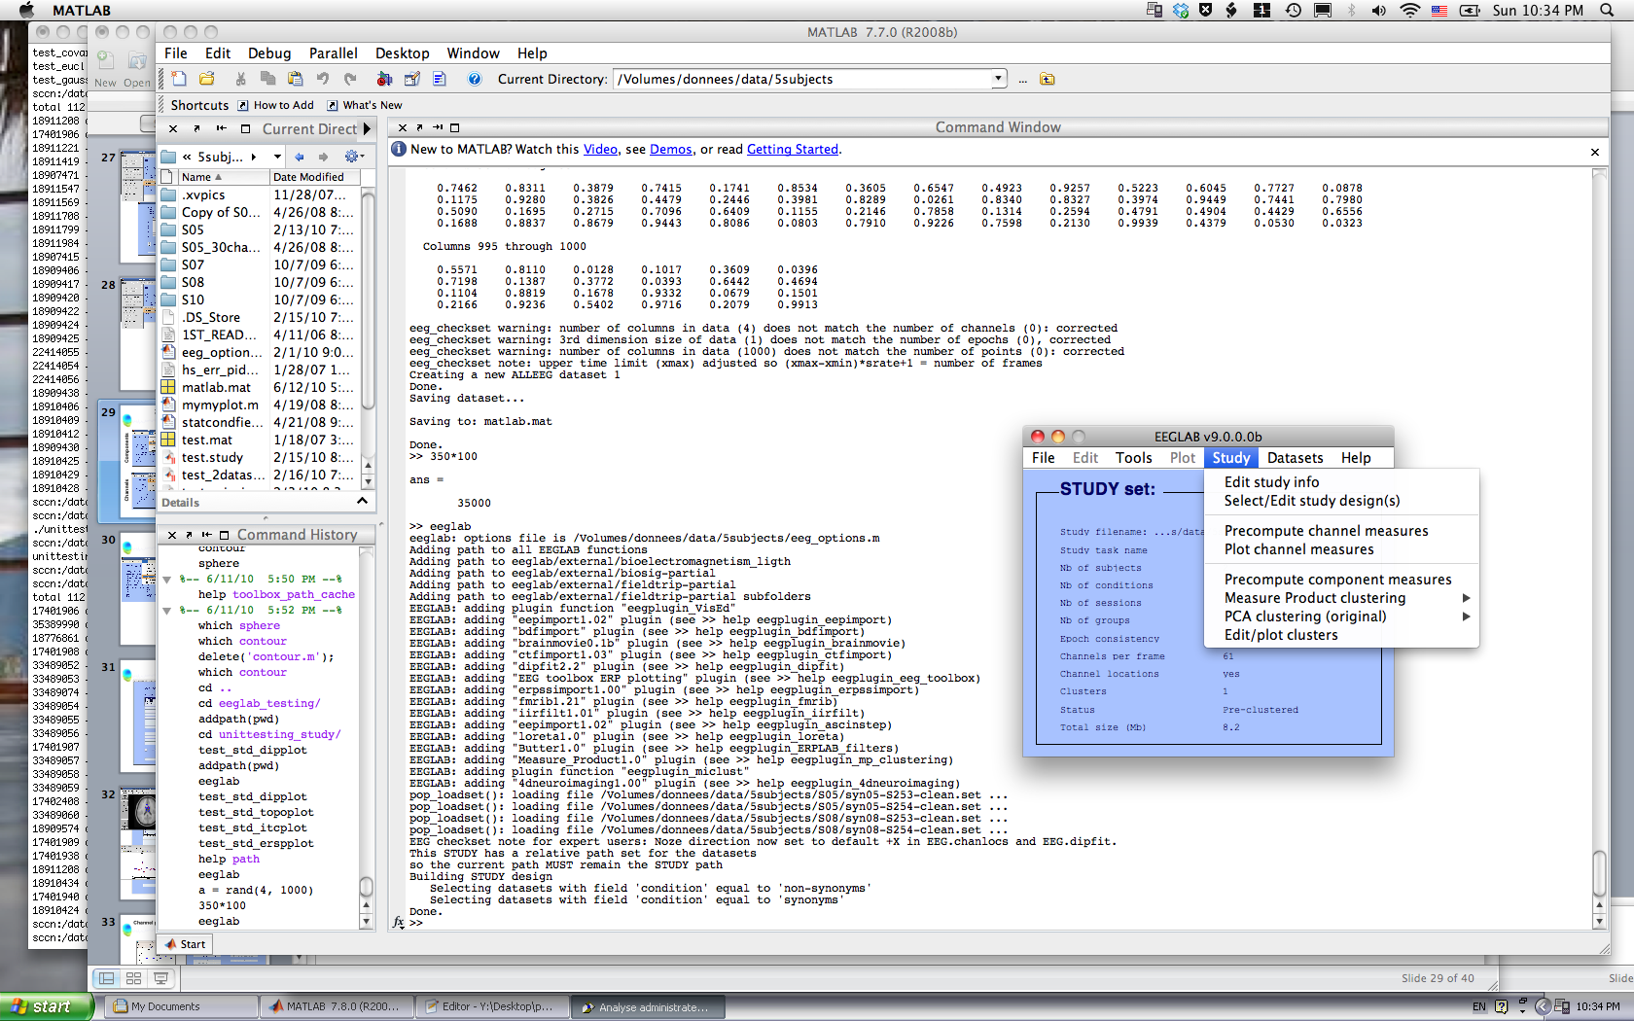
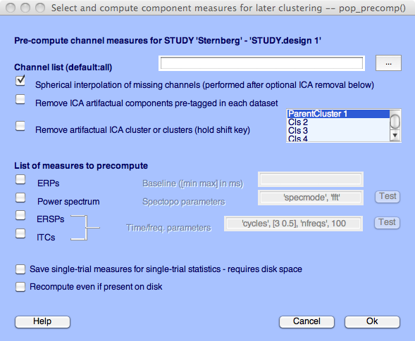
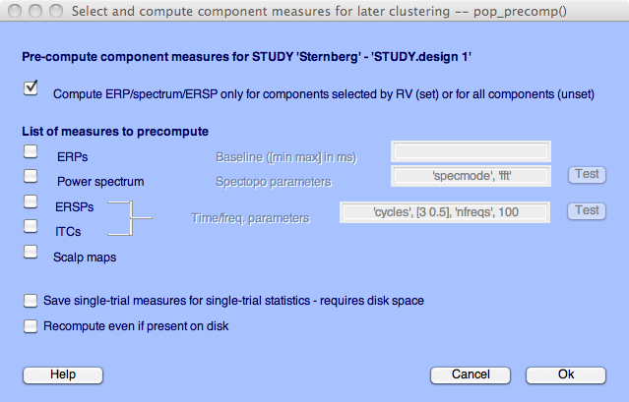
Pre-compute measures

Slide 14
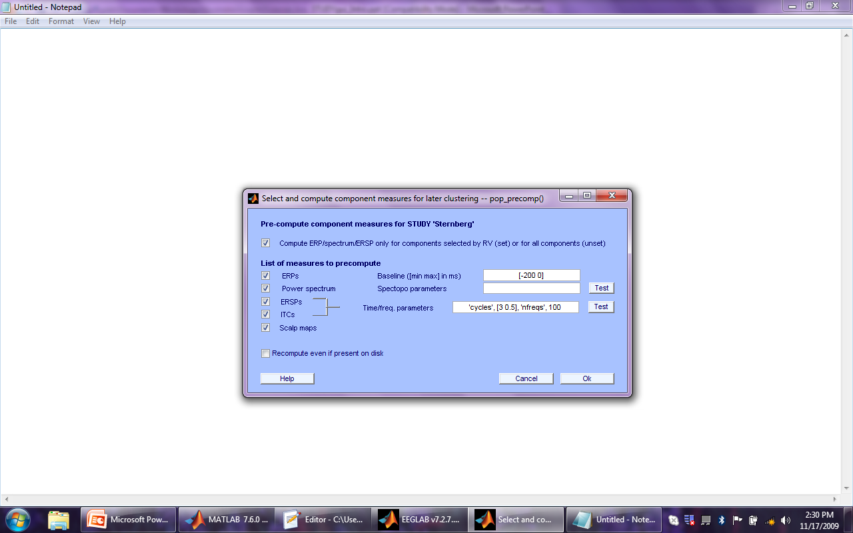
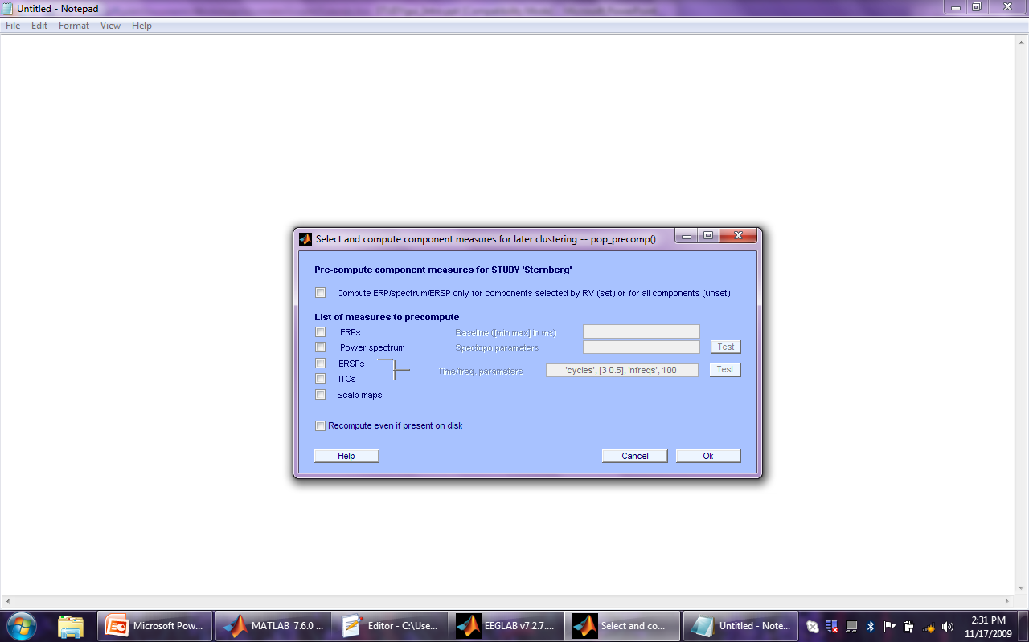
Precompute data measures
TIP: Compute all measures so you can
test different combinations for clustering
Time-frequency options

Slide 15
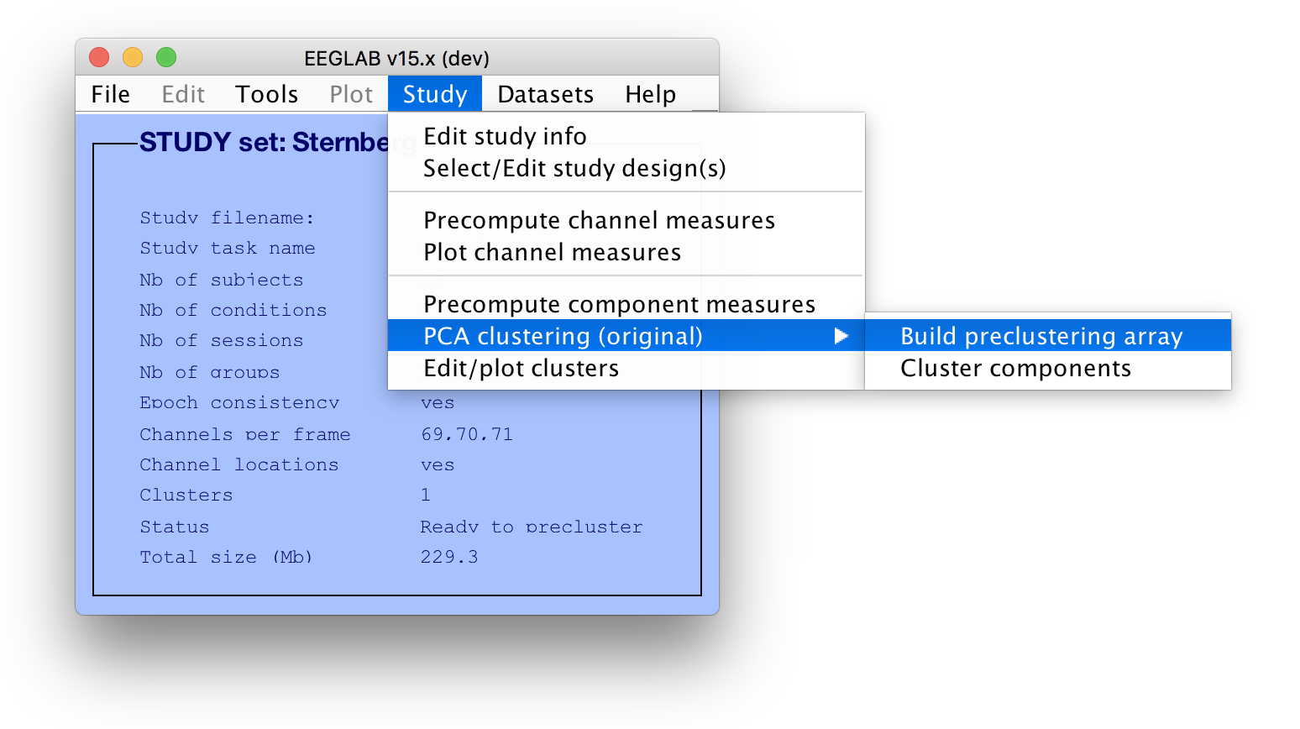
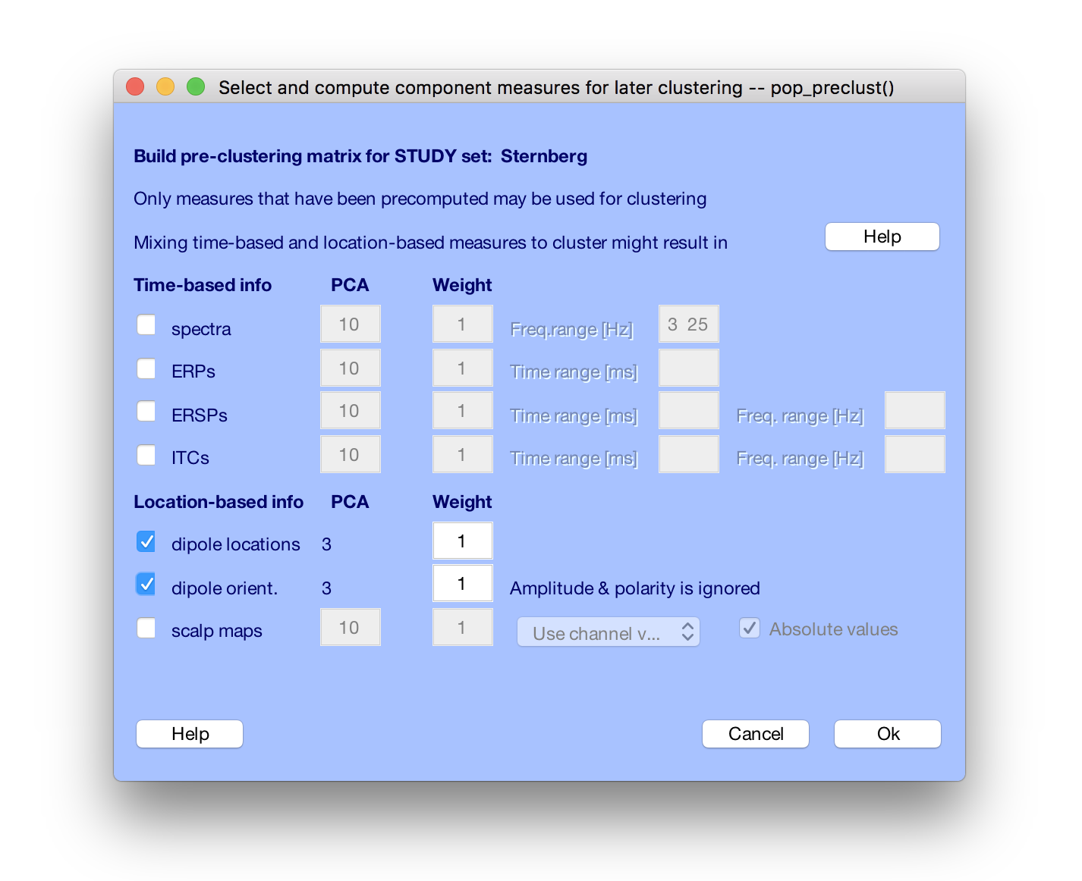
Cluster components

Slide 16
Precluster schematic
ICs (all subj)
PC
templates
Mean ERSPs
PCA
ICs (all subj)
ERSP
(time/freq)
# PCs

Slide 17
Precluster schematic
ICs (all subj)
PC
templates
Mean ERSPs
PCA
ICs (all subj)
ERSP
(time/freq)
# PCs
ICs (all subj)
PC
templates
Mean spectra
PCA
ICs (all subj)
Power
spectrum
*
# PCs
ICs (all subj)
ICs (all subj)
3D dipole position
*
ICs (all subj)
ICs (all subj)
x3
3D dipole moments
x3

Slide 18
Precluster schematic
ICs (all subj)
PC
templates
Mean ERSPs
PCA
ICs (all subj)
ERSP
(time/freq)
PC weights
# PCs
Ics/PCs (all subj)
ICs (all subj)
ERSP
PC
templates
Mean spectra
PCA
ICs (all subj)
Power
spectrum
*
PC weights
Spectrum
# PCs
Dip. positions
ICs (all subj)
ICs (all subj)
Dip. moments
3D dipole position
*
PC weights
ICs (all subj)
ICs (all subj)
x3
3D dipole moments
PC weights
x3

Slide 19
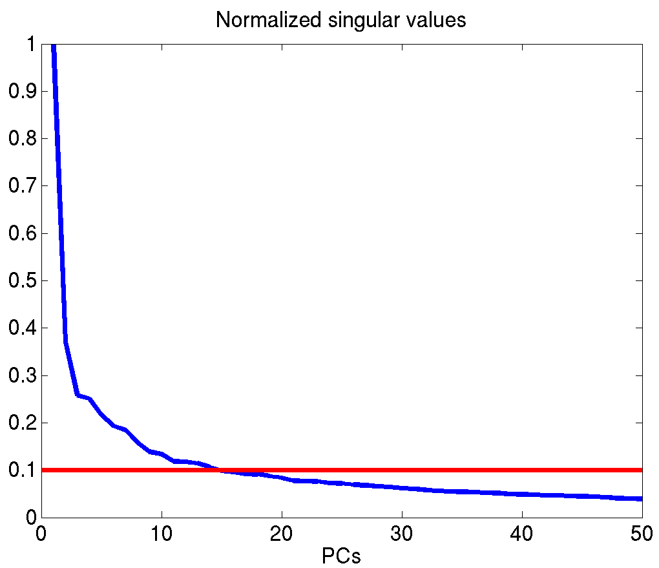
Precluster: Use singular values from PCA
Mean ERSPs
PCA
ERSP
(time/freq)
ERSP
(time/freq)
PC
templates
ICs (all subj)
# PCs
~ relative variance of
principal components
10% of max singular value

Slide 20
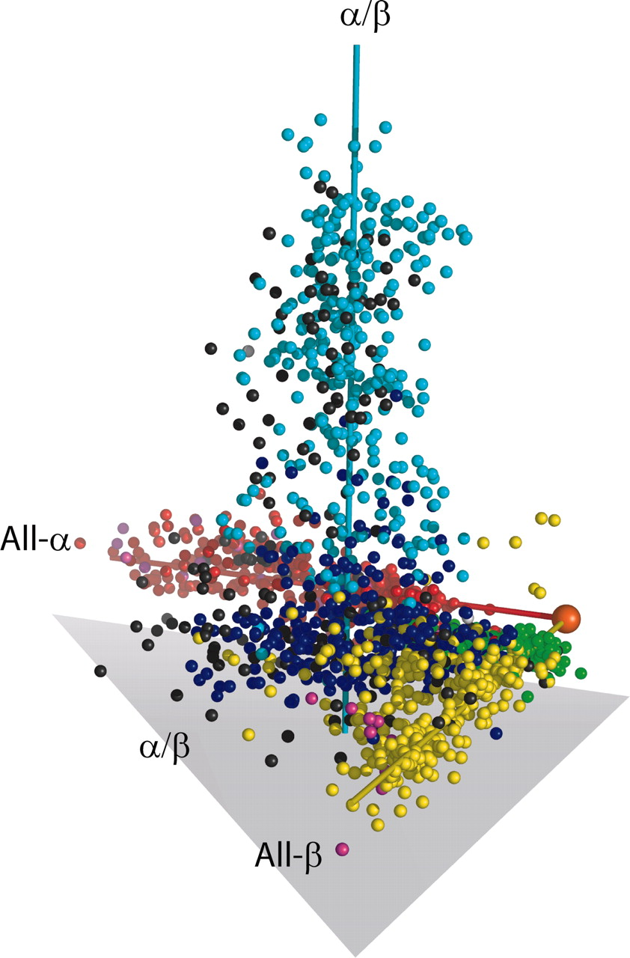
Precluster schematic
Each component is a dot
Clustering will group these
dots
ERSP
Spectrum
ICs (all subj)
Dipoles

Slide 21
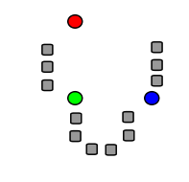
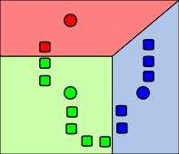
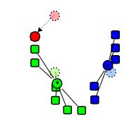
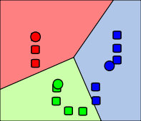
Standard Kmean Clustering
1. k initial "means" (in this case k=3, (shown in color)) are randomly selected from the data set (shown in grey).
2. k clusters are created by associating every observation with the nearest mean.
3. The centroid of each of the k clusters becomes the new means
4. Steps 2 and 3 are repeated until convergence has been reached.

Slide 22
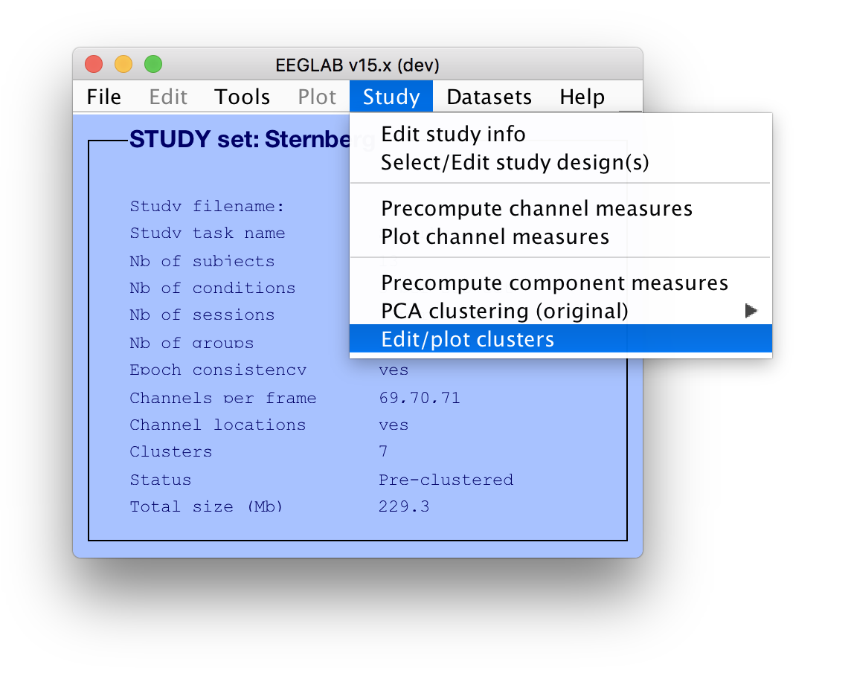
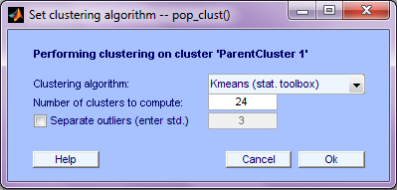
Cluster components

Slide 23
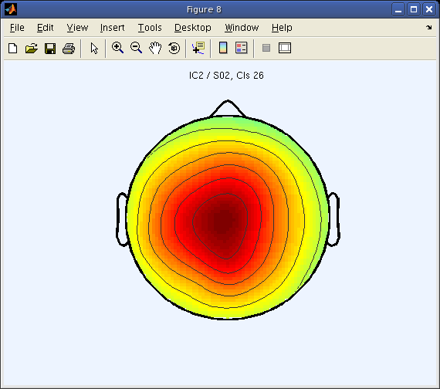
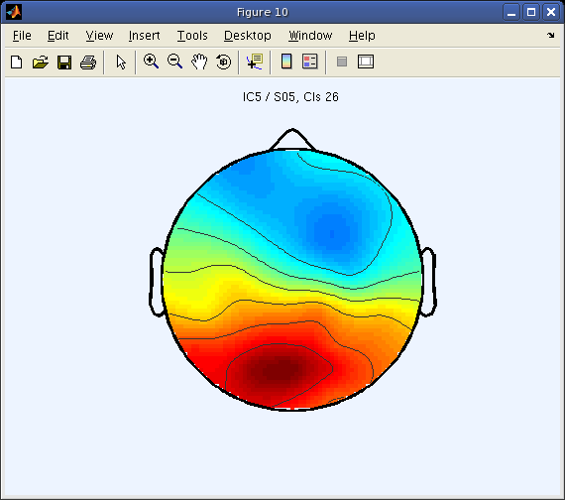
Choosing data measures
What measure(s) should you use?
It depends on your final cluster criteria…
- If for example, your priority is dipole location,
then cluster only based on dipole location…
But consider:
- What is the difference between these two components?

Slide 24
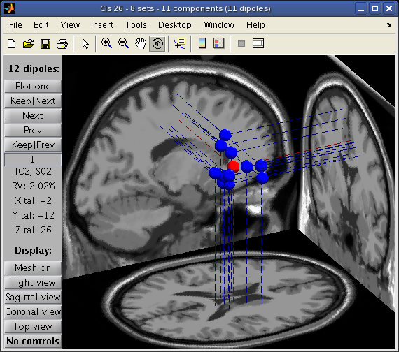
Choosing data measures
Similar dipole location,
very different orientation.
Obvious dramatic effect on
scalp map topography:
But, do they
perform the
same functions?

Slide 25
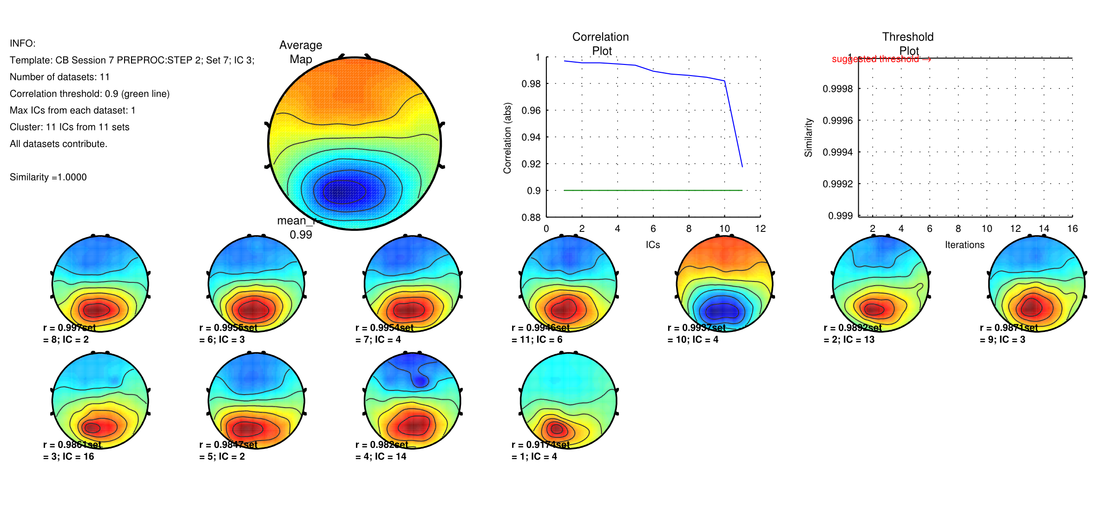
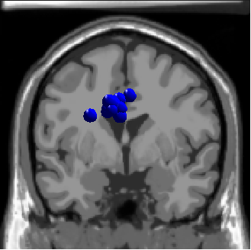
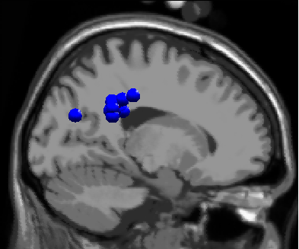
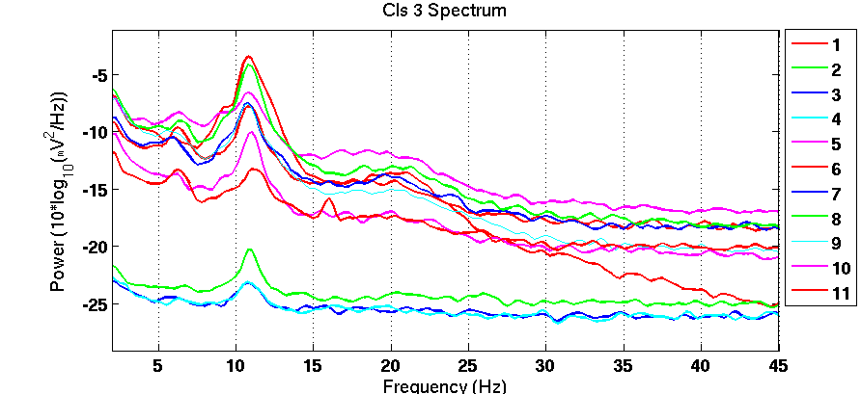
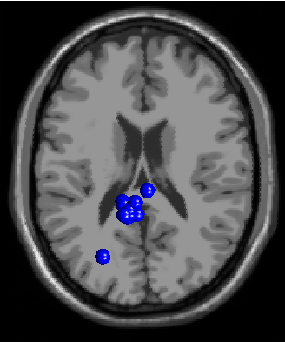
Results (Cluster 1 within subject)
100 % Sessions contribute

Slide 26
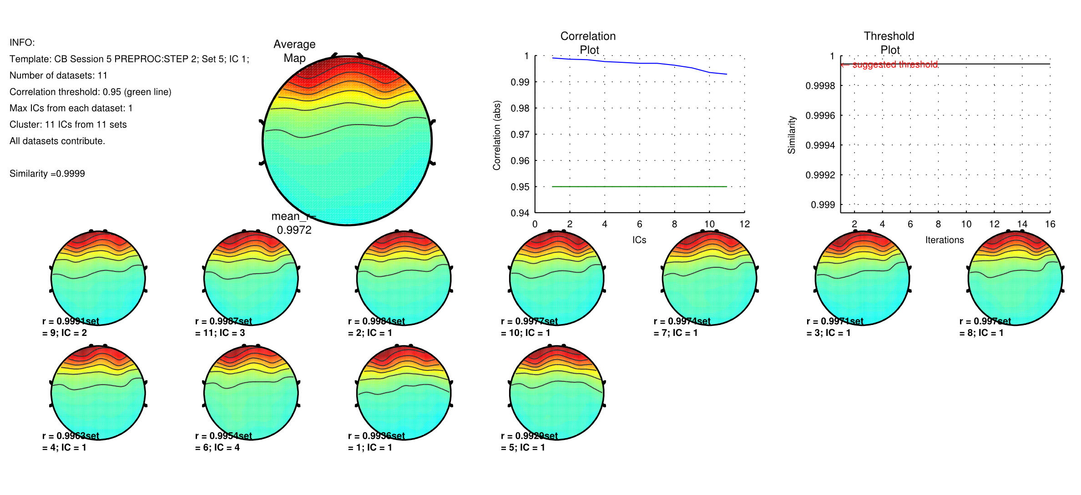
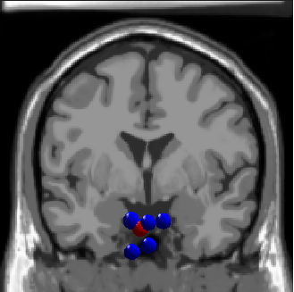
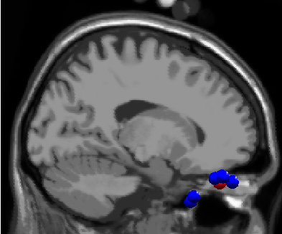
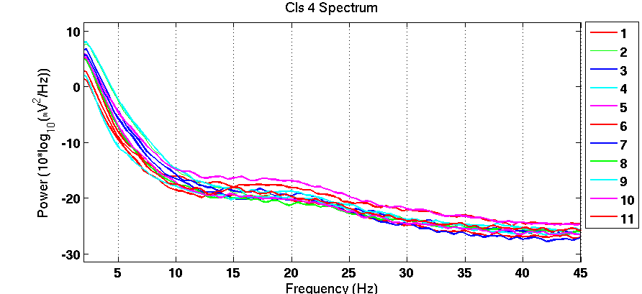
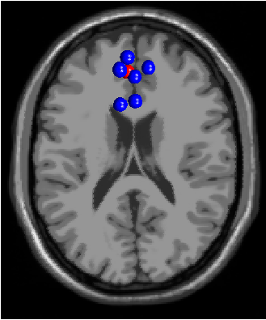
Results (Cluster 2 within subject)
100 % Sessions contribute

Slide 27
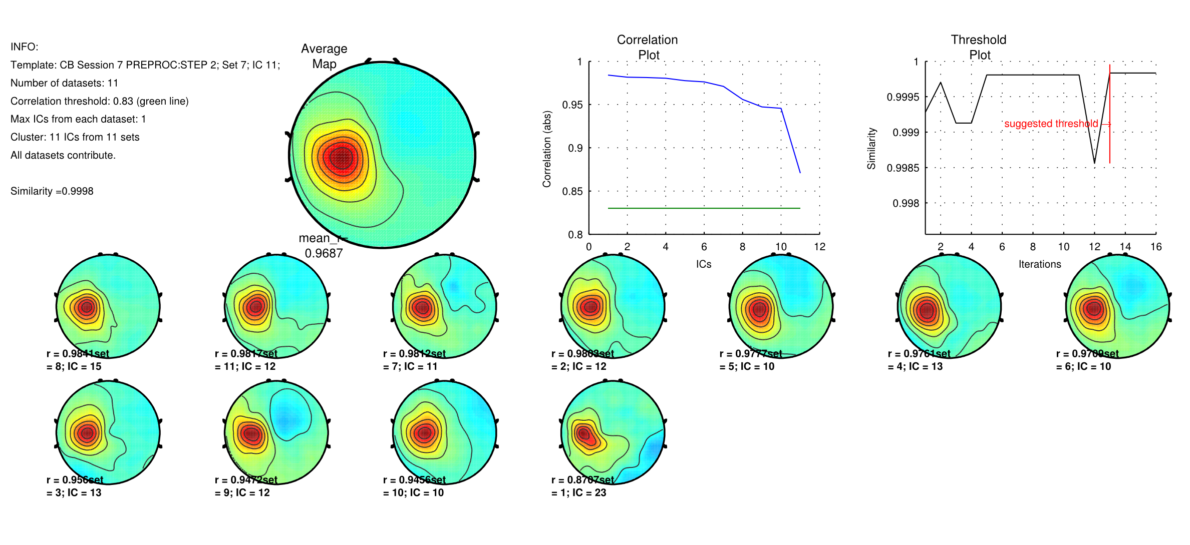
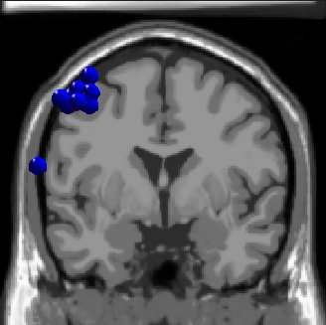
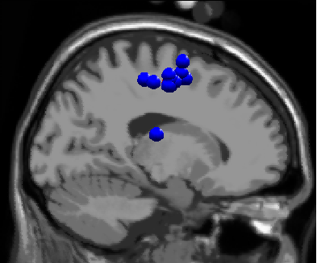
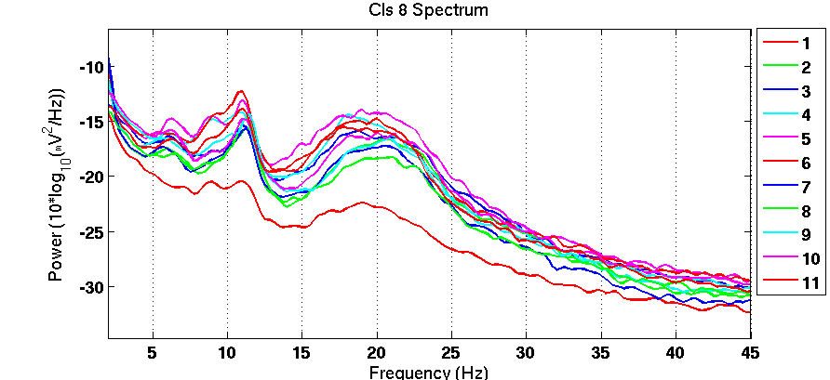
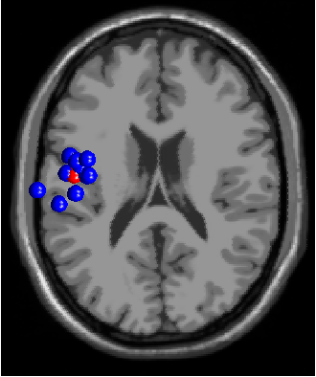
Results (Cluster 8 within subject)
100 % Sessions contribute

Slide 28
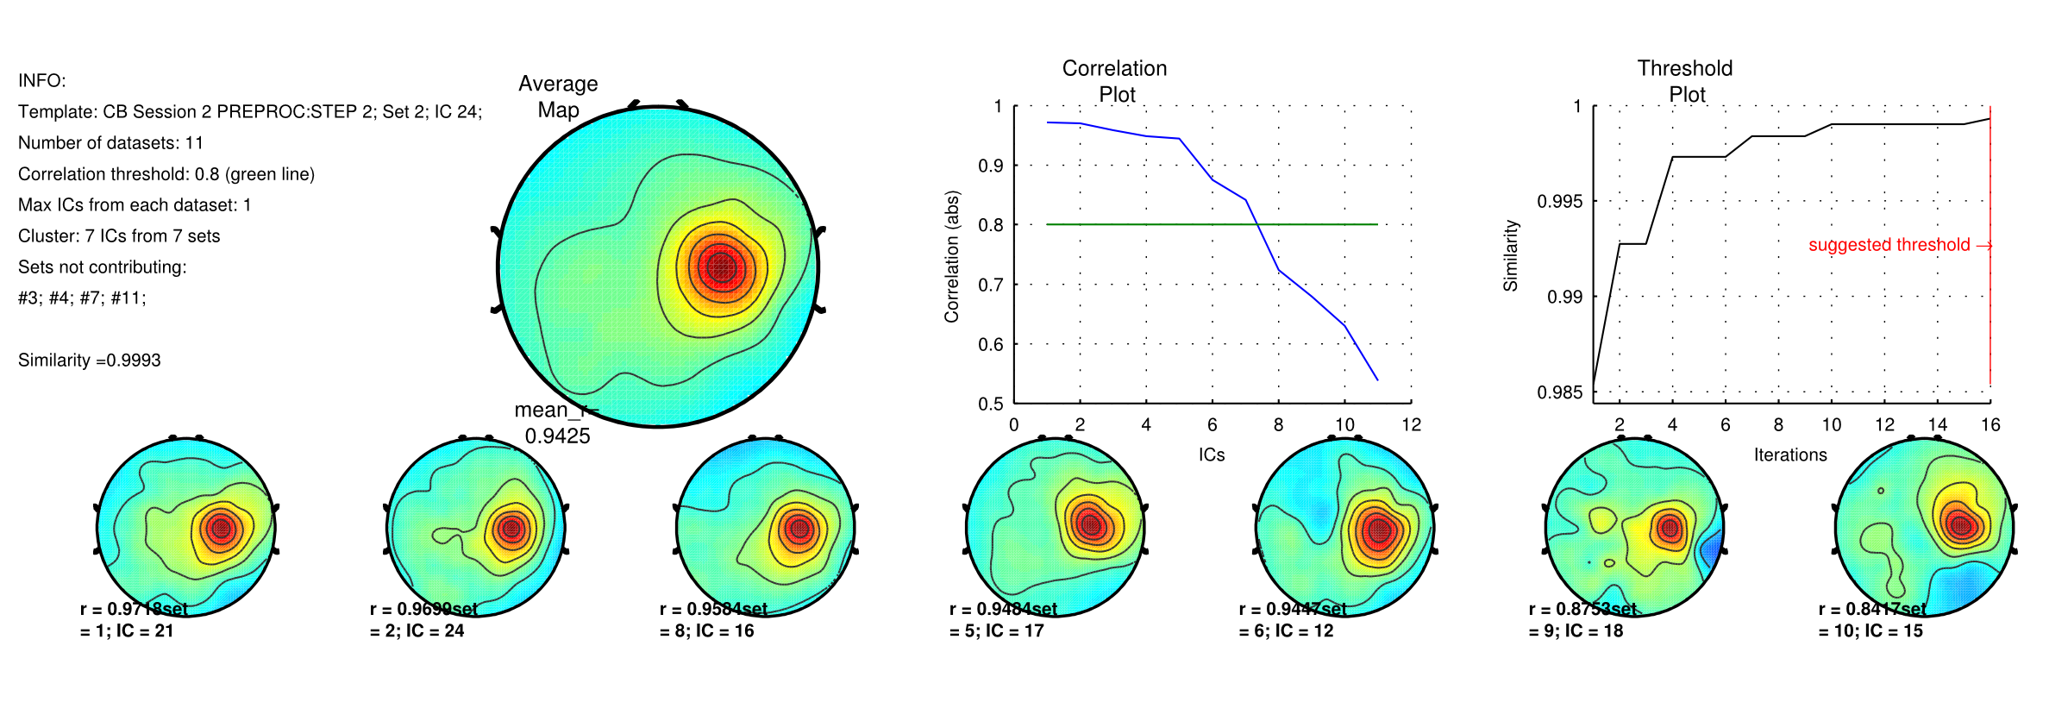
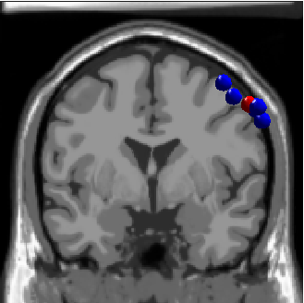
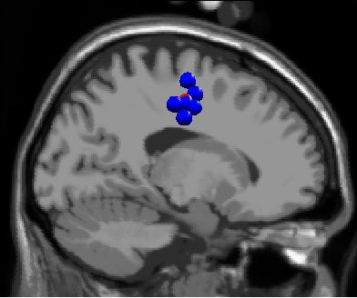


Results (Cluster 13 within subject)
63.64% Sessions contribute

Slide 29





Results (Cluster 14 within subject)
36.36% Sessions contribute

Slide 30
Validation of the ICA algorithm for EEG
Data
13 subjects performing a memory task
71 electrodes including EOGs
more than 300,000 data points/subject
Decomposition
23 ICA algorithms plus PCA and Promax
Analysis
Localization of all components with a single dipole
(4-shell spherical model)

Slide 31

Number of components with residual variance lower than a specific threshold
Notes:
Data
13 subjects performing a memory task
71 electrodes including EOGs
more than 300,000 data points/subject
Decomposition
23 ICA algorithms plus PCA and Promax
Analysis
Localization of all components with a single dipole
(4-shell spherical model)

Slide 32

More independence -> more biological components
Delorme, A., Palmer, J., Onton, J., Oostenveld, R., & Makeig, S. (2012). Independent EEG sources are dipolar. PLOS ONE, 7(2), e30135. https://doi.org/10.1371/journal.pone.0030135

Slide 33


Slide 35

Left μ cluster (across subjects)

Slide 36
Right μ cluster

Slide 37
Occipital α cluster

Slide 38
Frontal Midline θ cluster
Delorme, A., Palmer, J., Onton, J., Oostenveld, R., & Makeig, S. (2012). Independent EEG sources are dipolar. PLOS ONE, 7(2), e30135. https://doi.org/10.1371/journal.pone.0030135

Slide 39


Slide 40
ICA reliability across subjects
Different ICA algorithms return similar solutions
The ICA algorithms that return the most biologically plausible solutions are also the one that return the most independent decompositions

Slide 41
View and edit clusters

Slide 42

Plot/edit clusters

Slide 43


Plot cluster data
Plot mean scalp
maps for easy
reference

Slide 44


Plot cluster data
Choose
which
cluster
Choose which
components

Slide 45


Plot cluster data

Slide 46


Plot cluster data

Slide 47


Plot cluster data
Familiar
Scrambled
Unfamiliar

Slide 48

Familiar
Scrambled
Unfamiliar

Slide 49

IC contributions to ERP envelope

Slide 50

IC contributions to ERP envelope

Slide 51
Hands on
Load the STUDY ds002718/Face_detection.study
(download ds002718 from NEMAR and run the script Session_5_ds002718_preproc.m if needed)
Precompute spectrum for components, scalp topo.
Precluster and cluster components using dipole locations and dipole moments (KMean)
Look at your clusters. Identify frontal midline theta cluster(s) and occipital alpha cluster(s)
Look for a cluster generating a N170 and check dipoles location
Remove outliers if any

